Slide 1
How to put data into Catalyst
On the portal!

Slide 2




Catalyst
ABA Data Collection and Management
Notes:
Supervisors to have ppt, user guide, wifi flyer

Slide 3
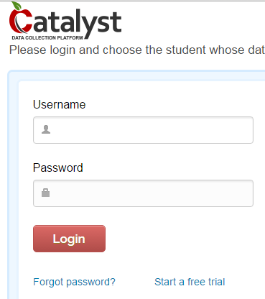

Online Portal
Go to https://secure.datafinch.com
When logging in for the first time, please select Forgot password? and enter your username
Username: ast.xxxxxxxx (ast.firstnamelastname)
To access an existing client account, chose the client from the drop-down list and click Continue. You can also type the student’s name into the search box.
Notes:
For now, don’t use SSO to access Catalyst if your area has SSO.

Slide 4
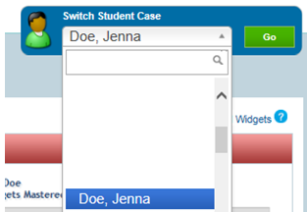
Navigating the Portal
The Switch Student Case drop-down menu: allows you to view or search for each client individually. Remember to click the Go button.
Tabs: Instructors will primarily use the Data Entry Tab, Documentation Tab, and Skill Acquisition Tab.

Slide 5
Data Entry Tab
The primary source of data collection for Catalyst is done on the tablet
If your devices fails in the field or if there are additional data that need to be added, you will enter the data in the portal. Discuss with your supervisor/manager when you should add data to the portal.
There can be issues when using Internet Explorer to enter data on Catalyst, so please enter data in another browser (e.g., Safari, Chrome, Firefox).

Slide 6
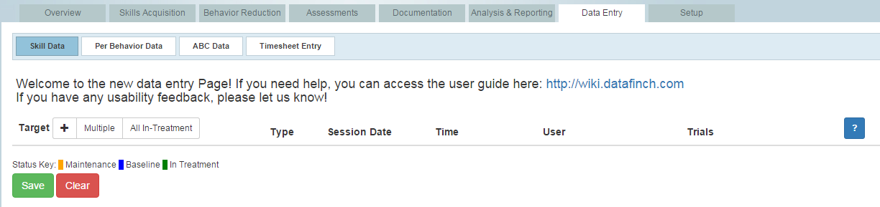
Entering Data
Go to Skill Data under Data Entry
If entering data for most of or all of a session:
Selecting “All in treatment” and then deleting programs that weren’t run is easier to set up.
If you ran maintenance programs as well, then select “All-> Maintenance-All” to add those programs.
Click All-In Treatment to add all current targets
Click + to add/select a single target
Click Multiple to add/select multiple targets

Slide 7
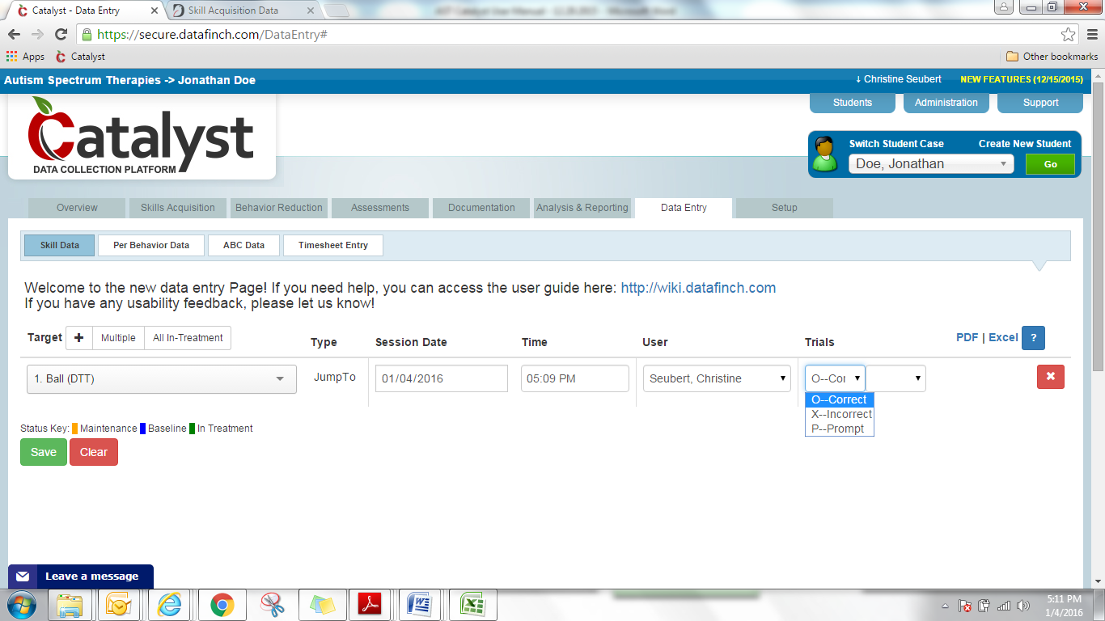
Entering Data
You must: add session date, session time, your name (under “user”), and the raw data.
Once if you selected “All in Treatment” or “Multiple”
For each program if you selected (+)
*IMPORTANT. Once all data are entered on the page, please click save button at the bottom left corner of the screen.
You will see a notice that your targets were saved successfully.

Slide 8
Entering Data
Tips!
In order to enter multiple trials for a target simply use the tab button and first letter of the prompt code (e.g., O for Correct).
Durations should be entered in hh:mm:ss format. (For example, if time was 2 hours and 30 minutes, you should enter it as 02:30:00).
If you did not run a program that day, delete the target by clicking on the red X on the right. If you do not delete targets without any data input, you may get an error when you try to save

Slide 9
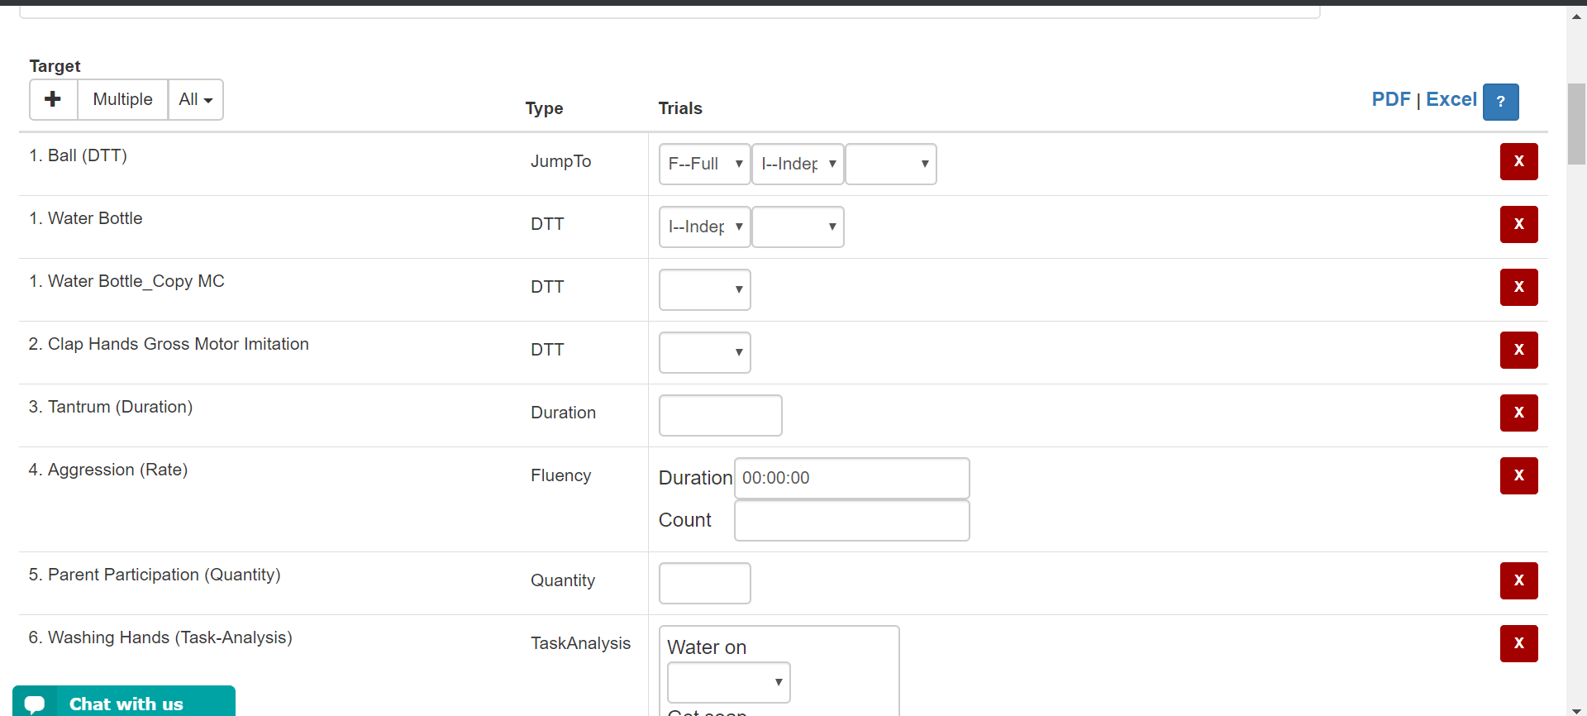
Data that you need to have ready
Data that you need to have ready
Hit the red X to delete any programs you did not run that session
NEVER delete behaviors for reduction - if the behavior didn’t occur that day, type in 0 for frequency or duration.

Slide 10
Data that you need to have ready
Data that you need to have ready
After you enter the first data point for the program, a new drop-down box appears so you can add the next data point.
Once you’ve added all your info for that program, leave the last drop down blank and move on to the next program

Slide 11
Data that you need to have ready
Data that you need to have ready
Be very careful to select the appropriate response – double check the prompts!

Slide 12
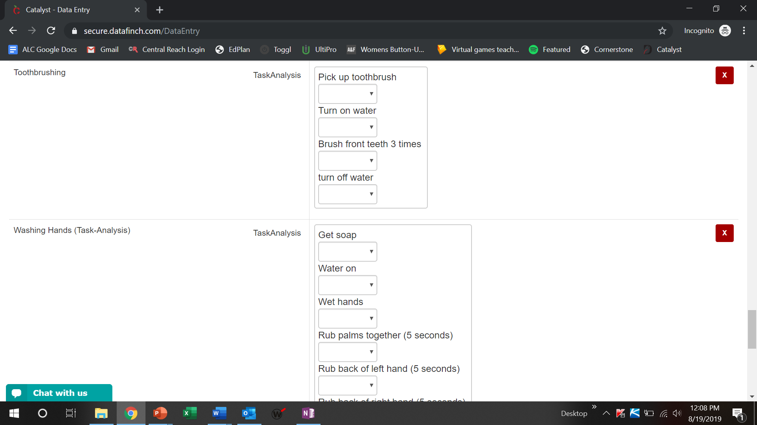
Data that you need to have ready
Data that you need to have ready
For task analyses, Put N/A/None if the step wasn’t run (e.g. in forward or backwards chaining)
Notes:
They need to select the prompts that are used in the program- MLC to let consultants know to be clear with prompts for data sheets if needed paper/pencil

Slide 13

BE EXTREMELY CAREFUL
BE EXTREMELY CAREFUL
Double check that all the data you input is accurate BEFORE saving the page
Is this the correct program/target
Is this the correct prompt
Is this the correct number of trials
Etc...
Accurate data allows us to make appropriate decisions regarding our client’s programming
Once you hit save you will not be able to see your data or change it!
The only way to edit is to go into every program, find the specific date, and edit each data point.
This is extremely time consuming and it is easy to miss something

Slide 14
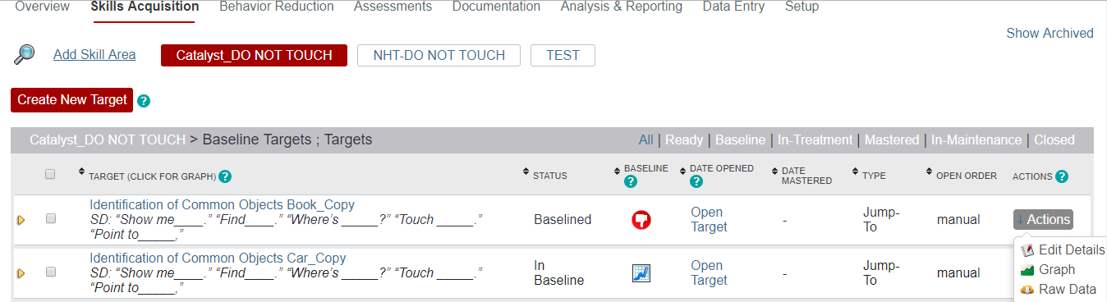
Checking Data Entry
Once you save your data entry, you can check the raw data:
Go to the Skill Acquisition Tab
Find the Program
Find the Target/Goal
Click Actions on the right
Click on Raw Data
Check your data (most current data will be first)

Slide 15
Obtaining Catalyst Support - Where to go for help!
IT Department:
All things related to tablet (e.g., charger, case, tablet login and password, etc.)
The Following Catalyst issues:
Updates, app freezing, not syncing, folder not created, folder renaming, folder disappearing, username/password
DataFinch:
Support@datafinch.com, chat on portal, OR submit support request
Following Catalyst issues:
Data missing, clock issues, Catalyst features
Catalyst passwords:
Portal password → reset on Catalyst portal/website
Pin password → reset on Catalyst portal/website
Scheduling:
Access to Client
Supervisor/Manager:
Any client specific questions, deletion of data, help with collecting data
Quick Catalyst Question - https://dftcatalyst.zendesk.com/
Or Melissa : Melissa.Clark@advancesonline.com
Notes:
IMPORTANT:
***You should see all of your regularly scheduled clients automatically.
***If assigned a same-day alternate case, you should automatically see the client once you re-sync your app for the day (if you do not see the same-day alternate client after re-syncing your device, contact scheduling for support).

